Slide 1



Noida Institute of Engineering and Technology, Greater Noida
Storytelling, Testing and Assessment
Unit: 3
Design Thinking II
MS. Barkha Bhardwaj
Assistant Professor (CSE-AI)
NIET, Gr. Noida
B Tech 5th Sem

Slide 2

Evaluation Scheme
Course Contents / Syllabus
UNIT-I | Introduction | 10 HOURS
Design thinking & Innovation, Design Thinking Mindset and Principles, recap of 5-Step Process of Design Thinking, Design Approaches, additional in-depth examples of each design approaches. Simon Sinek’s – Start with Why, The Golden Circle , Asking the “Why” behind each example (an in-class activity of asking 5-WHYS) , The Higher Purpose, in-class activity for LDO & sharing insights, Visualization and it’s importance in design thinking , reflections on wheel of life (in-class activity for visualization & Wheel of Life), Linking it with Balancing Priorities (in class activity), DBS Singapore and Bank of Americas’ Keep the Change Campaign. Litter of Light & Arvind Eye Care Examples, understanding practical application of design thinking tools and concepts, case study on McDonald’s Milkshake / Amazon India’s Rural Ecommerce & Gillette, Working on 1-hour Design problem, Applying RCA and Brainstorm on innovative solutions. Main project allocation and expectations from the project
UNIT-II | Refinement and Prototyping | 8 HOURS
Refine and narrow down to the best idea, 10-100-1000gm, QBL, Design Tools for Convergence – SWOT Analysis for 1000gm discussion. In-class activity for 10-100-1000gm & QBL Prototyping (Convergence): Prototyping mindset, tools for prototyping – Sketching, paper models, pseudo-codes, physical mockups, Interaction flows, storyboards, acting/role-playing etc, importance of garnering user feedback for revisiting Brainstormed ideas,Napkin Pitch, Usability, Minimum Viable Prototype, Connecting Prototype with 3 Laws, A/B Testing, Learning Launch. Decision Making Tools and Approaches – Vroom Yetton Matrix, Shift-Left,Up,Right, Value Proposition, Case study: Careerbuddy, You-Me-Health Story & IBM Learning Launch. In-class activities on prototyping- paper-pen / physical prototype/ digital prototype of project’s 1000gm idea
UNIT-III | Storytelling, Testing and Assessment | 8 HOURS
Storytelling: Elements of storytelling, Mapping personas with storytelling, Art of influencing, Elevator Pitch, Successful Campaigns of well-known examples, in-class activity on storytelling. Testing of design with people, conducting usability test, testing as hypothesis, testing as empathy, observation and shadowing methods, Guerrilla Interviews, validation workshops, user feedback, record results, enhance, retest, and refine design, Software validation tools, design parameters, alpha &beta testing, Taguchi, defect classification, random sampling, Final Project Presentation and assessing the impact of using design thinking
UNIT-IV | Innovation, Quality and Leadership | 6 HOURS
Innovation: Need & Importance, Principles of innovations, Asking the Right Questions for innovation, Rationale for innovation, Quality: Principles & Philosophies, Customer perception on quality, Kaizen, 6 Sigma. FinTech case study of Design Thinking application – CANVAS, Leadership, types, qualities and traits of leaders and leadership styles, Leaders vs Manager, Personas of Leaders & Managers, Connecting Leaders-Managers with 13 Musical Notes, Trait theory, LSM (Leadership Situational Model), Team Building Models: Tuckman’s and Belbin’s. Importance of Spatial elements for innovation
UNIT-V | Understanding Human Desirability | 8 HOURS
Achieve the comprehensive human goal: the five dimensions of human endeavour(Manaviya Vyavstha) are: Education- Right living (Sikhsa- Sanskar), Health – Self-regulation (SwasthyaSanyam), Justice – Preservation (Nyaya- Suraksha), Production – Work ( Utpadan – Karya), Exchange – Storage (Vinimya – Kosh), Darshan-Gyan-Charitra (Shifting the Thinking), Interconnectedness and mutual fulfilment among the four orders of nature recyclability and self-regulation in nature, Thinking expansion for harmony: Self-exploration (Johari’s window), group behaviour, interpersonal behaviour and skills, Myers-Briggs personality types (MBTI), FIRO-B test to repair relationships.

Slide 3
Branch wise application
Design thinking helps in businesses by optimizing the process of product creation, marketing, and renewal of contracts.
The education sector can make the best use of design thinking by taking feedback from students on their requirements, goals and challenges they are facing in the classroom.
The IT industry makes a lot of products that require trials and proof of concepts. The industry needs to empathize with its users and not simply deploy technologies.
Design thinking helps in healthcare as well. Experts worldwide are concerned about how to bring quality healthcare to people at low cost.

Slide 4
Course Objective
The objective of this course is to upgrade Design Thinking skills by learning & applying advanced and contextual Design Thinking Tools. It aims to solve a Real-Life Problem by applying Design Thinking to create an impact for all the stakeholders

Slide 5
Course Outcome
COURSE OUTCOME NO. | COURSE OUTCOMES | Bloom’s Knowledge Level (KL)
CO1 | Learn sophisticated design tools to sharpen their problem-solving skills | K4
CO2 | Generate innovate ideas using design thinking tools and converge to feasible idea for breakthrough solution | K1, K3
CO3 | Implement storytelling for persuasive articulation | K2,K4
CO4 | Understanding the nature of leadership empowerment | K3, K5
CO5 | Understand the role of a human being in ensuring harmony in society and nature. | K2, K3

Slide 6
Program Outcomes (POs)
PO1: Engineering knowledge
PO2: Problem analysis
PO3: Design/development of solutions
PO4: Conduct investigations of complex problems
PO5: Modern tool usage
PO6: The engineer and society
PO7: Environment and sustainability
PO8: Ethics
PO9: Individual and team work
PO10: Communication
PO11: Project management and finance
PO12: Life-long learning

Slide 7
CO-PO Mapping
CO-PO Mapping
PO No. CO No. | PO1 | PO2 | PO3 | PO4 | PO5 | PO6 | PO7 | PO8 | PO9 | PO10 | PO11 | PO12
CO3 | 2 | 2 | 1 | 2 | 2 | - | 3 | 1 | 3 | 2 | 2 | 3
*3= High *2= Medium *1=Low

Slide 8
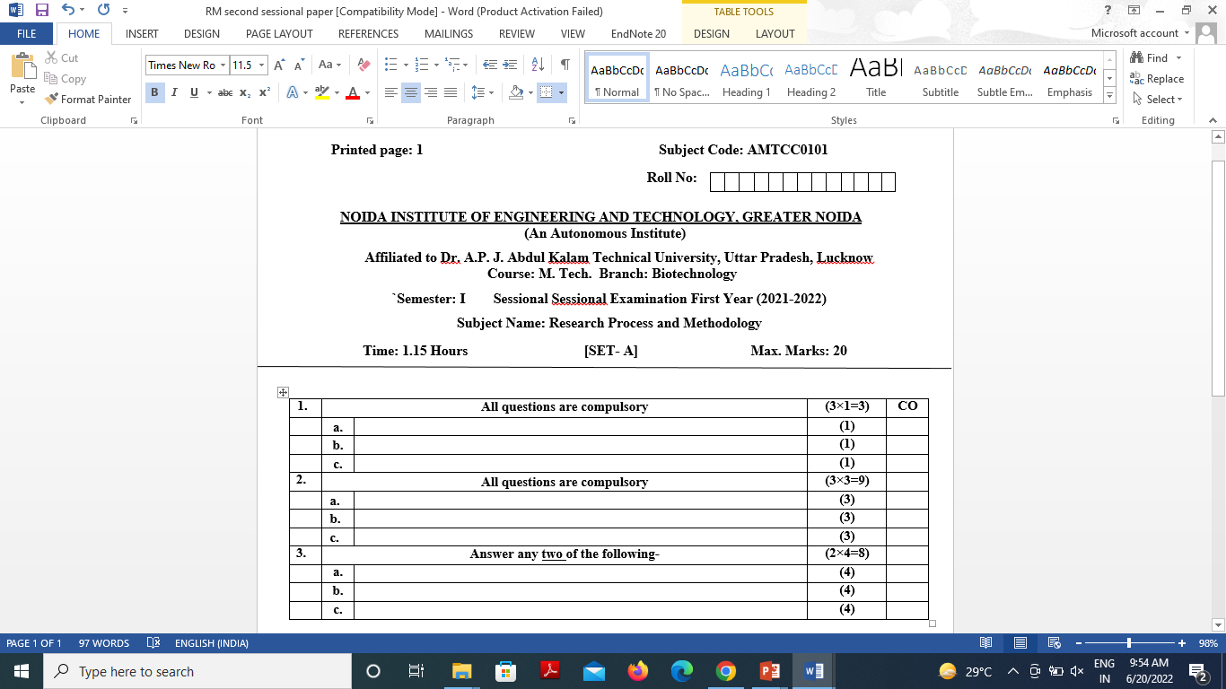
SESSIONAL PAPER TEMPLATE

Slide 9
Question Paper Template
 |  | SECTION – A |  | CO
1. | Attempt all parts- |  | [10×1=10]
 | 1-a. | Question- | -1
 | 1-b. | Question- | -1
 | 1-c. | Question- | -1
 | 1-d. | Question- | -1
 | 1-e. | Question- | -1
 | 1-f. | Question- | -1
 | 1-g. | Question- | -1
 | 1-h. | Question- | -1
 | 1-i. | Question- | -1
 | 1-j. | Question- | -1
2 | Attempt all parts- |  | [5×2=10] | CO
 | 2-a. | Question- | -2
 | 2-b. | Question- | -2
 | 2-c. | Question- | -2
 | 2-d. | Question- | -2
 | 2-e. | Question- | -2

Slide 10
Question Paper Template
SECTION – B |  |  |  | CO
3 | Answer any five of the following- |  | [5×6=30]
 | 3-a. | Question- | -6
 | 3-b. | Question- | -6
 | 3-c. | Question- | -6
 | 3-d. | Question- | -6
 | 3-e. | Question- | -6
 | 3-f. | Question- | -6
 | 3-g. | Question- | -6

Slide 11
Question Paper Template
SECTION – C ​ |  |  | ​ | CO​
​ |  |  | ​ | ​
4​ | Answer any one of the following-​ |  | [5×10=50]​ | ​
​ | 4-a.​ | Question- ​ | -10​ | ​
​ | ​ | ​ | ​ | ​
​ | 4-b.​ | Question- ​ | -10​ | ​
5​ | Answer any one of the following-​ |  | ​ | ​
​ | 5-a.​ | Question- ​ | -10​ | ​
​ | ​ | ​ | ​ | ​
​ | 5-b.​ | Question- ​ | -10​ | ​
6​ | Answer any one of the following-​ |  | ​ | ​
​ | 6-a.​ | Question- ​ | -10​ | ​
​ | ​ | ​ | ​ | ​
​ | 6-b.​ | Question- ​ | -10​ | ​
7​ | Answer any one of the following-​ |  | ​ | ​
​ | 7-a.​ | Question- ​ | -10​ | ​
​ | ​ | ​ | ​ | ​
​ | 7-b.​ | Question- ​ | -10​ | ​
​ | ​ | ​ | ​ | ​
8​ | Answer any one of the following-​ |  | ​ | ​
​ | 8-a.​ | Question- ​ | -10​ | ​
​ | ​ | ​ | ​ | ​
​ | 8-b.​ | Question- ​ | -10​ | ​

Slide 12
Prerequisite and Recap
Student should have basic knowledge of design thinking process.

Slide 13
Brief Introduction about the subject with videos
Design Thinking is not an exclusive property of designers — all great innovators in literature, art, music, science, engineering, and business have practiced it. So, why call it Design Thinking? What’s special about Design Thinking is that designers’ work processes can help us systematically extract, teach, learn and apply these human-centered techniques to solve problems in a creative and innovative way — in our designs, in our businesses, in our countries, in our lives.
https://careerfoundry.com/en/blog/ux-design/what-is-design-thinking-everything-you-need-to-know-to-get-started/
https://www.youtube.com/watch?v=-ySx-S5FcCI

Slide 14
Topic Objective
Topic | Objective
Storytelling, its elements | Study about ways to effectively tell story to customers.
Mapping personas with Storytelling | Develop understanding how users will find the effectiveness of your product.
Successful campaigns | Develop understanding how a product campaign gained popularity using empathy.
Testing Design, usability, hypothesis with empathy | Examine test elements that will have more acceptance and impact on user.
Observation and Shadowing | Study user behavior with qualitative research technique by observation.
Validation workshop, tools | To obtain user feedback and opinions
Feedback and refine design | Examine feedback and refine design to gain better user acceptance
Alpha, Beta testing | To verify quality of product.
Defect Classification and Random sampling | Study quality control before product reaches user.

Slide 15

What is Storytelling? (CO3)
What is Storytelling(CO3)?
Designers use storytelling to get insight into users, build empathy and reach them emotionally. Designers create personas to represent target users and add conflict to stories that reflect their user journeys and problems. Crafting stories, designers can better understand what users want from a solution.​
The art of powerful storytelling. Everyone has stories to tell, but storytelling is a skill that can be developed and as a tool it can be used to powerful effect. Developed and used purposefully, storytelling can contribute to inclusion and connection, build confidence, and bring about change.​

Slide 16
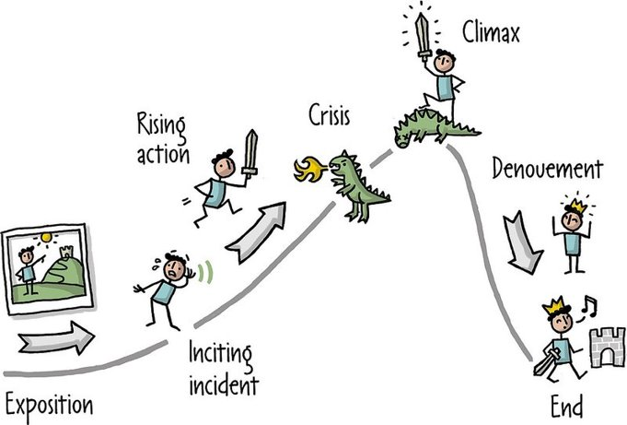
Storytelling (CO3)
You can use storytelling in your design process to present your user research results in an engaging way and create empathy with your target users. This will help you steer the design process and keep it user-centric.​

Slide 17

Storytelling (CO3)

Slide 18
Why Storytelling​ (CO3)
After completing design research to understand your users’ needs and desires.​
You use your insights to tell a story about who your users are, what they need and how you’ll provide that. ​
The story makes it easy for everyone involved in the project to empathize with the users and ensure that their work matches the story.​
Having a story throughout your project means marketing the design at the end of the design process is also straightforward, as you already know exactly which story to tell to show how your product provides value.​

Slide 19
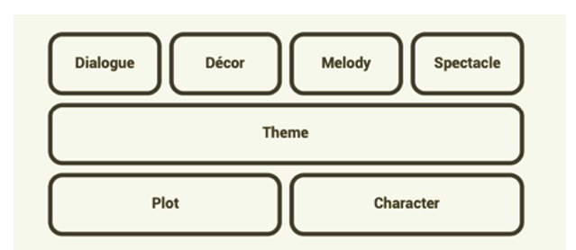
Aristotle’s 7 Elements of Good Storytelling (CO3)

Slide 20
Important elements of storytelling (CO3)
Plot – What are users trying to achieve/overcome?​
Character – Who are the users: not just demographically, but what insights do you need to understand what they (and their needs) are truly like?​
Theme – How can you establish a trustworthy presence to them and still set yourself apart from competitors? How will you reflect the overall obstacles users must overcome?​
Dialogue/Diction – What will your design say to users and how? Does a formal/informal tone match their expectations? How much text is appropriate?​
Melody – How will the overall design pattern appear pleasant and predictable to users, moving them emotionally?​
Décor – How will you present everything so the graphics match the setting the users can sense? Would a classic design or stylized, niche layout meet their expectations?​
Spectacle – How can you make your design outstanding so users will remember it?

Slide 21

Important elements of storytelling (CO3)

Slide 22
Personas mapping with storytelling (CO3)
Story mapping is a visual exercise to capture the journey a customer takes with the product including activities and tasks they perform with the system to achieve certain goals or objectives. Personas can be mapped with storytelling. Steps:​
Define your target users with personas– To envision users’ likely experiences and gain empathic insights. Personas are based on user research but tell a story about your insights. ​​
Example: Rick, a 47-year-old manager struggling with his work–family-life balance. He even works on his train commutes. Feeling drained, he wants better control of his life.​
Mapping personas with storytelling involves creating detailed narratives around personas (fictional users) to make their needs, goals, and pain points more relatable. This helps teams better understand and empathize with users, leading to more user-centered design solutions.
Example If designing a fitness app, the persona "Mark," a busy corporate employee, can be mapped with a story that highlights his daily struggle to find time for workouts and how a fitness app can help him schedule quick sessions. This makes the persona more engaging and helps designers focus on specific features like time-saving workout plans.

Slide 23
Personas mapping with storytelling (CO3)
Create a plot, with conflict – to make the personas heroes and envision how they can overcome specific problems using your design. Make this a mapped-out journey or storyboard with each persona’s aim/s clearly defined. E.g.:
Rick discovers your (yet-to-be-designed) time-management app online. He downloads it and completes your questionnaire about work commitments, family, outgoings, etc.
He starts using your app, letting it collect data from his phone and fitness tracker about time on various tasks/activities, stress levels, alertness, etc.
After a week, your app charts his tasks and activities, including sleep, heart-rate data, etc.
Tapping a phone tab, Rick sees time-management suggestions on how to become more productive, well-rested, etc.
He has the option to continue or suspend monitoring (e.g., if on holiday/vacation).

Slide 24
Personas mapping with storytelling (CO3)
Give your design the supporting role – Show it improving your persona’s/user’s life and how easy it is to use. ​
Example: Consider how many steps Rick needs to use your app and if voice-controlled devices at home might influence its suggestions.​
​
Work with the setting –When and where users use your design is vital for building empathy. ​
For Rick, it’s the home, train and workplace. But what about (e.g.) busy professionals working from home?​
Tailor the look/feel – A design’s appearance is vital regardless of its functional benefits, so design the most appropriate (e.g.) layout, colors, typography. ​
For example:​
Rick prioritizes at-a-glance, easy-to-use design, but soothing colors would complement larger fonts, etc.​

Slide 25
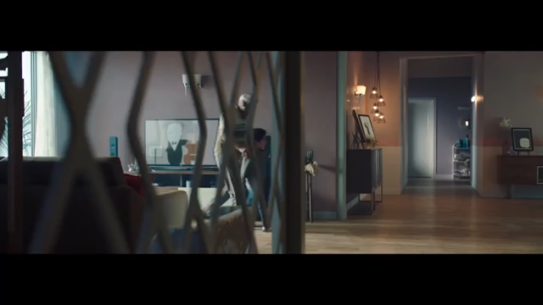
Personas mapping with storytelling (CO3)

Slide 26

Personas mapping with storytelling (CO3)

Slide 27
Personas mapping with storytelling (CO3)
Always Consider
The What – The user problem/s you define: E.g., They work too much overtime because of…? Budgeting problems at home?
The Who – The users themselves, envisioned through personas. This includes people who play influential roles in the main user’s/persona’s story. You can identify them using customer journey maps.
The How – Your story arc, with a beginning, middle and end. From introducing the player/s at the beginning, you build towards their biggest problems (which many factors can affect) and finish with the happy ending your design delivers.

Slide 28
Personas mapping with storytelling (CO3)
Strategic Storytelling can elevate influence as a designer and inspire action in an organization. It allows enhanced collaboration with stakeholders, build influence, and change attitudes and behaviors. How can a well crafted story help:​
​
Thought Leadership​
Highlight the conflict that was resolved. Integrate the key data points or the reasons why the approach works into a larger narrative to make those reasons stand out and the data points more memorable.​
​
Performance Reviews ​
Showcase the impact through a concise, powerful story. It helps in getting valuable feedback and also detail of the challenges you overcame helps in solution designing making a difference for users—and maybe even the business at large. ​
​
Research Readouts ​
Make one user the protagonist of your story—walking your colleagues through particular challenges they face and why those challenges are relevant. Storytelling can illuminate research insights and user testing results in new ways, helping as you ideate on how to implement user feedback or work to align various stakeholders. ​

Slide 29
Personas mapping with storytelling (CO3)
Future Vision​
Create a character based on a persona to explain your vision. Consider the example of a busy, stressed-out parent who doesn’t have time for household chores. In the future vision, this parent is thriving, healthy, happy and able to spend quality time with their kids. That’s a powerful image that makes the case for your product: an app that lets users schedule household service providers.​
​
Design Value​
Share the story of how a particular user’s experience has improved because of a design change. What attribute to the impact of design—and a powerful way to explain why users love a new feature.​
​
Project review ​
Craft a story about what your team accomplished at the close of a design project. Share how a persona’s goals were accomplished thanks to the work you did. Assessing the final results with stakeholders and gaining the feedback you need to move forward will be effective.​
​

Slide 30
Ways to engage audience​ (CO3)
​
1. Benefit the other​
Be a great brand evangelist. “Evangelism comes from a Greek word meaning bringing the good news. The crux of evangelism is the benefit of the other person.” Unlike other forms of sales, evangelism is focused on helping others.​
​
2. Focus on differentiation & value​
Use a 2x2 matrix to find what to work on. The vertical axis measures differentiation or uniqueness, while the horizontal axis represents value. Focus on things in the upper right-hand corner of the matrix—both unique and valuable. For example, the iPod was successful because it was the only device with an easy-to-use interface, and it could also deliver a wide selection of music legally and inexpensively.​ This framework not only applies to products and services but also how you consider your own value and personal brand. ​

Slide 31
Ways to engage audience (CO3)
3. Build trust​
To gain trust, it should go both ways. Take example of Zappos, which offers free shipping both ways, a policy that could have easily been abused. However, the company trusted their customers by default, which encouraged them to order shoes online. This mutual trust ultimately created the foundation for Zappos’ success.​
​
4. Back up your recommendations with story​
Stories are powerful tool as they are memorable, stories are relatable, stories break the ice. ​
​
The Opposite Test: Listen to your competitors and how they describe their product. Then, use adjectives and descriptions that are the opposite of what they’re saying. ​
​
The Elevator Pitch: It’s important to be brief. You should be able to explain anything in 30 seconds. ​
​
By mastering these skills, you’ll be able to get closer to changing hearts and minds. But don’t feel discouraged if you don’t get it right the first time. Failure is a better teacher than success.

Slide 32

Successful Campaigns (CO3)
Some of the campaigns are determined by the growth of the brand as well and the social media success after the advertising campaign. ​
​
Example :​
​
1. Volkswagen: Think Small ​
The Volkswagen “Think Small” campaign was created in 1960 by a well-known advertising group Doyle Dane & Bernbach.​
What the group set out to do was to answer one question – how to change people’s perceptions about a product. American always liked to buy big and 15 years after WWII they were still not buying small German cars. The thing about Volkswagen is that they never tried to be something there weren’t which is what people still today love about the brand - truth about a product.​

Slide 33
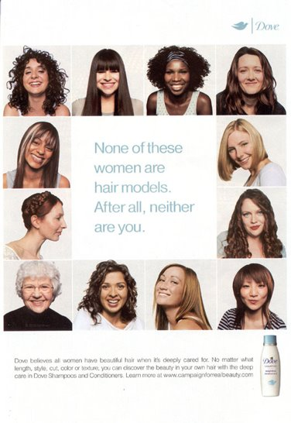
Successful Campaigns (CO3)
Dove: Real Beauty​
Dove’s real beauty campaign was all about beauty products giving you confidence, not anxiety.​
The campaign began turning heads in 2004 about topics that were sensitive but meaningful to their customers. The campaigns were shared, uploaded and translated across 110 countries.​
​

Slide 34

Successful Campaigns (CO3)

Slide 35
In class activity on story telling (CO3)
In class activity on story telling

Slide 36
Testing of design with people (CO3)
Testing is the fifth stage in the five-stage design thinking process.
Testing is, quite simply, the process of testing your prototype on real users.
During the test phase, you’ll see how your target users interact with your prototype, and gather valuable feedback.
You’ll learn where your prototype succeeds and where it needs to be improved.
The insights gathered during the testing phase will enable you to iterate on your prototype.

Slide 37
5 Guidelines for Conducting a Test (CO3)
Show, don’t tell: let your users experience the prototype
Ask test participants to talk through their experience.
Observe your users.
Ask follow-up questions.
Negative feedback is your way to learn and improve.

Slide 38
Benefits of Testing (CO3)
User testing saves time and money
By catching errors and usability issues early on, you ensure that the product you eventually launch is the most bug-free, user-friendly product it can be.
User testing reveals unexpected insights.
No matter how thorough your initial user research was, or how convinced you are that you’ve designed the optimal solution to your user’s problem, there are always new insights to be uncovered.
User testing improves user satisfaction.
Design Thinking is all about putting the user first. By gathering first-hand user feedback, you can make informed design decisions—improving user satisfaction in the long run.

Slide 39
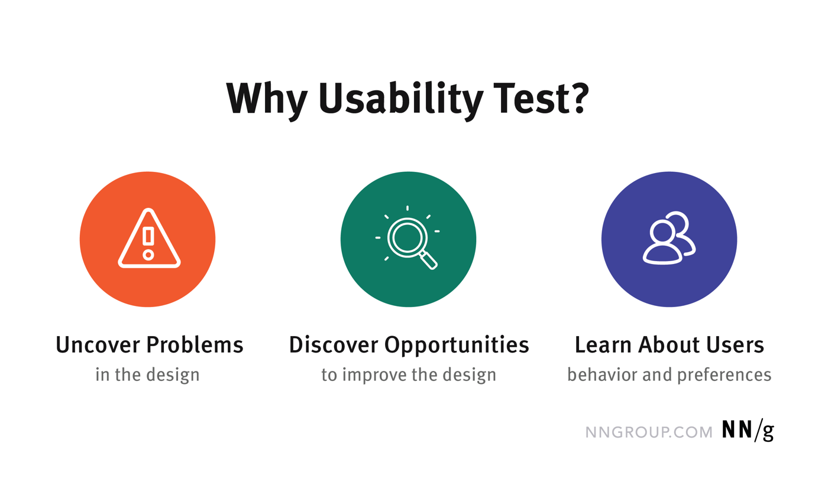
Usability Test (CO3)
https://www.nngroup.com/articles/usability-testing-101/

Slide 40
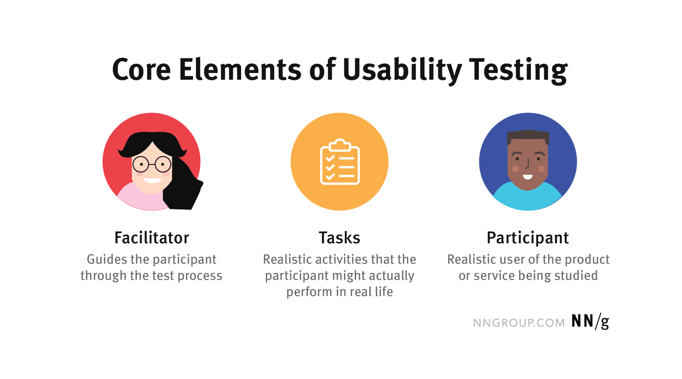
Usability Testing (CO3)
https://www.nngroup.com/articles/usability-testing-101/

Slide 41
Conducting User Testing (CO3)
When it comes to running user tests, there are certain steps you need to follow—regardless of your chosen method:
Set an objective
Build your prototype
Create a plan
Recruit participants
Gather all the necessary equipment
Document your findings
https://careerfoundry.com/en/blog/ux-design/user-testing-design-thinking/

Slide 42
User testing methods (CO3)
Remote vs. in-person user testing
During in-person testing, you’ll be in the same room as the user while they test your prototype. This has several advantages. Not only are you able to control the testing environment and keep distractions to a minimum; you can also directly observe the user.
Remote user testing offers a less expensive, more convenient alternative, but you’ll have little to no control over the user’s testing environment.
Moderated vs. unmoderated user testing
Moderated remote user testing is a good middle ground between in-person tests and completely unmoderated remote tests. Live remote testing allows you to observe your users over a video call, for example. You can use a screen recording app to capture the test, and certain programs will also track and highlight where the user clicks in your digital prototype.
Unmoderated tests can be conducted via user testing platforms such as UserZoom, loop11, and usertesting.com. If you’re short on time, such tools make it easy to conduct user tests quickly and with minimal effort. However, you won’t have the opportunity to observe the users or ask them questions.

Slide 43
User testing Techniques (CO3)
1. Concept testing
In the very early stages of the design process, you’ll want to test out your initial concepts before actually designing them.
Low-fidelity prototypes—a simple sketch, or even static images—can be used to communicate your idea to your target users.
You’ll then interview your users to gauge how they feel about the concept. Is it a product or feature they’d be interested in using? Does it have the potential to solve the user’s problem?
2. A/B testing
A/B testing is used to compare two different versions of a design. This method can be used at any stage of the design process, whether you have paper prototypes or fully clickable digital ones.
In A/B testing, you’ll create two different prototypes and test each version on a different set of users. You might test two different layouts, for example, or different copy for a certain CTA button on a certain screen.
It’s important to only A/B test one variable at a time so as not to skew the results

Slide 44
User testing Techniques (CO3)
3. Usability testing
A crucial user testing method that should be used repeatedly throughout the design process, usability testing shows you how easy your design is to use.
Usability testing is usually an observational exercise: you’ll ask your users to complete certain tasks, and observe them as they do so (this is part of a task analysis).
Throughout the test, you’ll see which aspects of the design caused problems for the user, as well as which aspects appear to be user-friendly.
In doing so, you’ll identify usability issues which you’ll seek to fix in the next iteration of your prototype.
4. First-click testing
When designing an app or a website, you want to make sure that the user takes the intended action whenever they land on a certain page or screen.
First-click testing shows you what your users first steps are when they encounter an interface; in other words, where do they click first?
This helps you to determine which visual elements and content should take priority, where buttons, icons, and menu items should be located, as well as the kind of language you should use for buttons and labels.
First-click testing can be conducted using both low and high-fidelity prototypes

Slide 45
User testing Techniques (CO3)
5. Tree testing
Once you’ve come up with the information architecture of your digital product, you can use tree testing to see how user-friendly it really is.
You’ll present the user with a “tree” of information—representative of how your site menus would be laid out—and ask them to find specific items.
If users struggle to locate certain information, you’ll need to rethink your information architecture.
Tree testing is often conducted as a remote, unmoderated study, but it can also be done in person using paper prototypes.

Slide 46
Types of Usability Testing (CO3)
Qualitative vs. Quantitative
Qualitative usability testing focuses on collecting insights, findings, and anecdotes about how people use the product or service. Qualitative usability testing is best for discovering problems in the user experience. This form of usability testing is more common than quantitative usability testing.
Quantitative usability testing focuses on collecting metrics that describe the user experience. Two of the metrics most commonly collected in quantitative usability testing are task success and time on task. Quantitative usability testing is best for collecting benchmarks.

Slide 47
Types of Usability Testing (CO3)
Remote vs. In-Person Testing
Remote usability tests are popular because they often require less time and money than in-person studies. There are two types of remote usability testing: moderated and unmoderated.
Remote moderated usability tests work very similarly to in-person studies. The facilitator still interacts with the participant and asks her to perform tasks. However, the facilitator and participant are in different physical locations. Usually, moderated tests can be performed using screen-sharing software like Skype or GoToMeeting.
Remote unmoderated remote usability tests do not have the same facilitator–participant interaction as an in-person or moderated tests. The researcher uses a dedicated online remote-testing tool to set up written tasks for the participant. Then, the participant completes those tasks alone on her own time. The testing tool delivers the task instructions and any followup questions. After the participant completes her test, the researcher receives a recording of the session, along with metrics like task success.

Slide 48
Testing as Hypothesis (CO3)
Hypothesis testing is a formal procedure for investigating our ideas about the world using statistics. It is most often used by scientists to test specific predictions, called hypotheses, that arise from theories.
It is an analysis tool that tests assumptions and determines how likely something is within a given standard of accuracy.
Hypothesis testing provides a way to verify whether the results of an experiment are valid.
A null hypothesis and an alternative hypothesis are set up before performing the hypothesis testing.

Slide 49
Steps in Hypothesis Testing (CO3)
State your research hypothesis as a null hypothesis and alternate hypothesis (Ho) and (Ha or H1).
Collect data in a way designed to test the hypothesis.
Perform an appropriate statistical test.
Decide whether to reject or fail to reject your null hypothesis.
Present the findings in your results and discussion section.

Slide 50
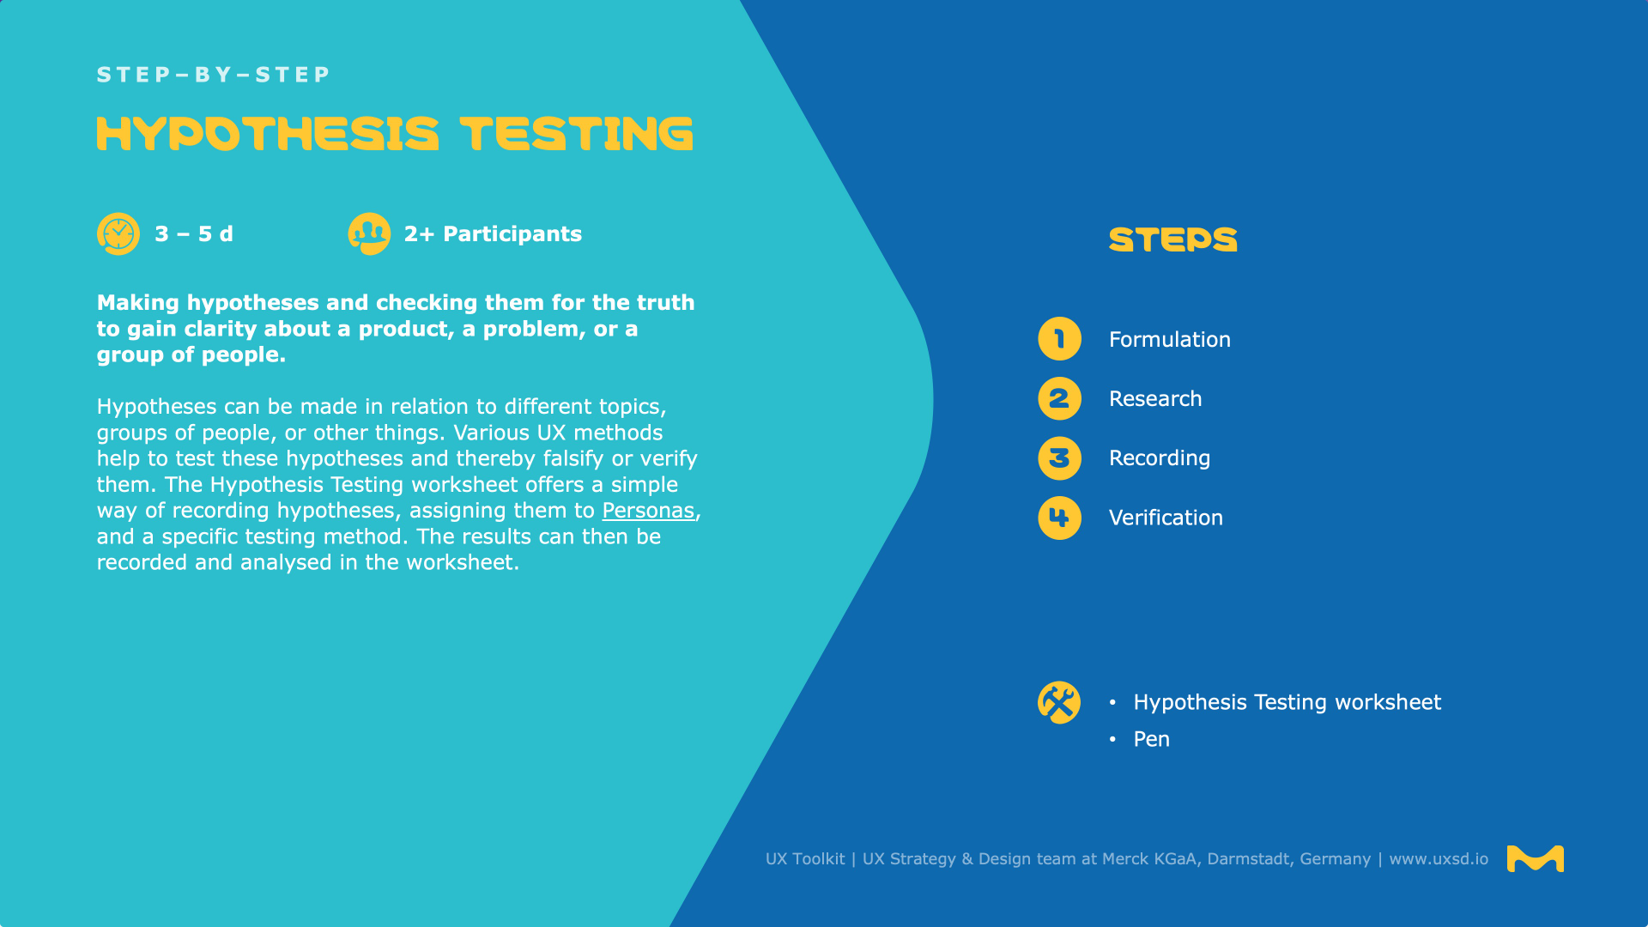
Steps in Hypothesis Testing (CO3)

Slide 51

Steps in Hypothesis Testing (CO3)

Slide 52

Steps in Hypothesis Testing (CO3)

Slide 53

Steps in Hypothesis Testing (CO3)

Slide 54

Steps in Hypothesis Testing (CO3)

Slide 55
Observation and Shadowing Methods (CO3)
Qualitative research is based on the observation and collection of non-numerical insights. The results describe the frustrations and desires of the users. This information will help us to constantly improve the product.
To really understand what people do, we can’t just ask them, we have to observe them. The observation provides accurate information about people, their tasks, habits, their needs and pain points.
Observation means looking, listening, and thinking carefully about what we’re seeing and hearing, so we can find out specific details.
Observation helps us to find out extensive information about mood, body language, pace, interaction style, user habits, and timing and gives us a full picture user’s point of view.
The goal is to observe participants’ natural behavior, without interrupting them or affecting their behavior.
Regular observation sessions provide useful feedback to us which can be used for constant product improvement. They also help us to create and adjust personas.

Slide 56
Shadowing (CO3)
Shadowing is, by its very nature, a qualitative research technique.
It is too time consuming and resource intensive to be conducted on a massive scale and thus it’s important to realize that it is best used to provide the basis for further quantitative research which offers statistically significant insights rather than being used as the end point of research.
The key principle of shadowing is that the researcher acts as an observer only.
They are not to interfere with the research subject (participant) as that interference might change the way that the subject behaves in any given circumstance.
Thus shadowing is somewhat different from customer observational interviewing practices in which the researcher fully interacts with the participant while they observe them in their usual environment.

Slide 57

Guerrilla Interviews (CO3)
Guerrilla Interviews: meet people at public spaces such as parks and coffee shops and engage in quick conversations related to your research topic

Slide 58
What is guerrilla research/interview? (CO3)
Guerrilla research is a quick, low-cost way of learning about and understanding experiences.
It is usually done in public spaces and does not require a rigorous recruitment process, although it does require its own type of planning.
Especially when facing pushback from stakeholders regarding the cost of user research or the benefits of user-centered design, guerrilla research can prove the value of research with minimal investment.
Its inherent flexibility—online or offline, one day or one week, sessions as short as ten minutes—makes it an easier sell than a full research program.

Slide 59
Advantages of guerrilla Testing/interview (CO3)
You can move fast.
If you have no research budget, it’s better than no testing at all.
It’s super cheap compared to more formal research.
It can be a great way to validate/invalidate early assumptions.
It can be an excellent way to identify areas to do deeper research on.
It can work well with small-iterations type work.

Slide 60
Disadvantages of guerrilla Testing/interview (CO3)
Not a lot of time spent with participants, so you’re restricted to a small part of the flow.
It may be more difficult to convince stakeholders about the insights you generate.
The people you chat with may not be the types of people that will use your product.

Slide 61
The three Fs of guerrilla user research (CO3)
1. Focused: Set intentions and know your scope
As with most projects that are centered in design-thinking, focus on the problem that you want to solve rather than the solution you plan to develop. The more specific your problem is, the more impactful guerrilla research can be. Focusing your scope is the true game-changer that allows you to cut back on costs and time spent. Narrowing your scope doesn’t have to impact the quality of insights you get.
2. Fast: Make feedback collection easy and simple
Oftentimes, when we throw around the term ‘guerrilla’ research, we envision a model, known as street intercepts, where you approach strangers and collect live feedback. This approach has long existed in the user researcher’s toolkit. But what if your company has neither a physical product to offer nor the resources to send a team out into the public?
3. Frugal: Save money as a way to be a team player
Making the case for a UX design and user research-specific budget can be challenging at some companies. But what better way to advocate for the impact of user research than by running a low-cost user research experiment?

Slide 62
User Feedback (CO3)
User feedback is any information collected from users or customers about their experience using your product or service.
This user feedback can be either proactive, that is, you solicit it from users, or reactive, meaning that your users sent you the feedback unprompted.
Feedback can come from many different channels and in many different forms.
Types of feedback include things like bug reports, support requests or suggestions about how your product can be improved.
Channels include live chat, in product surveys, email, phone and more.
After collecting feedback, it’s then used by various teams to improve the user or customer experience.

Slide 63
Types of User Feedback (CO3)
Proactive
Proactive feedback is feedback that you actively solicit from your users or customers. This can include things like the NPS (net promoter score) surveys that we’re all familiar with (more on those below). Or more specific questions focused on aspects of your product experience, such as onboarding. Generally proactive feedback is designed to help you understand a specific aspect of your users’ experience.
Reactive
Reactive user feedback is that which comes unsolicited from your users or customers. Some of the most common examples are things like bug reports or support requests. For example, a user tells you that they keep getting logged out of your product. Or the new feature that you just released isn’t working the way that it’s supposed to. Because this type of feedback is often an indication that your user is having a negative experience or is even unable to use your product, you should respond and resolve it quickly.

Slide 64
Types of User Feedback (CO3)
Ongoing
This is an important category of feedback that many companies don’t handle particularly well. In addition to the categories above, you can collect ongoing feedback by making it easy for your users to provide constructive input on the product experience at any time. By providing feedback channels right inside your product experience, you show your users that you really value their input. For example, provide an easy way for users to make feature requests while using your app.

Slide 65
How to Collect User Feedback (CO3)
Run in-app surveys
Customer Effort Score
Customer Happiness Index
Conduct customer interviews
Net Promoter Score (NPS) surveys
Collect other in-app feedback
Offer live chat

Slide 66
Reporting Usability Test Results (CO3)
Reporting Usability Test Results
When reporting results from a usability test, you should focus primarily on your findings and recommendations that are differentiated by levels of severity. Include the pertinent information from the test plan and present just enough detail so that the method is identifiable. Keep the sections short, use tables to display the metrics, and use visual examples to demonstrate problem areas, when possible.
Data Analyses
At the end of usability testing you will have collected several types of data depending on the metrics you identified in your test plan. When analyzing the data you’ve collected, read through the notes carefully looking for patterns and be sure to add a description of each of the problems. Looks for trends and keep a count of problems that occurred across participants.

Slide 67
Software validation tools (CO3)
Design thinking is a human-centered approach to innovation, focused on gaining empathy about customer’s problems and challenges in order to create solutions or products and services that satisfy their wants and needs.
This framework or process requires different techniques and tools than your overall “business as usual” and product design efforts.
To help with this approach, there are many software tools and applications that you can utilize during the design thinking process.
Here are some popular software tools for design thinking that you can evaluate yourself to see if digital tools can help you.

Slide 68
Software validation tools (CO3)
Sprintbase
Miro
MURAL
Shape by IDEO
Smaply
Digsite
Batterii
Stormboard
Google Docs, Sheets, & Slides
Conceptboard
Google Jamboard
Shape
FigJam

Slide 69
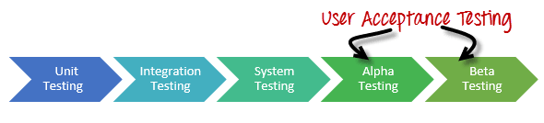
Alpha Testing (CO3)
Alpha Testing is a type of acceptance testing; performed to identify all possible issues and bugs before releasing the final product to the end users.
Alpha testing is carried out by the testers who are internal employees of the organization.
The main goal is to identify the tasks that a typical user might perform and test them.
To put it as simple as possible, this kind of testing is called alpha only because it is done early on, near the end of the development of the software, and before beta testing.
The main focus of alpha testing is to simulate real users by using a black box and white box techniques.

Slide 70
Beta Testing (CO3)
Beta Testing is performed by “real users” of the software application in “real environment” and it can be considered as a form of external User Acceptance Testing.
It is the final test before shipping a product to the customers. Direct feedback from customers is a major advantage of Beta Testing.
This testing helps to test products in customer’s environment.
Beta version of the software is released to a limited number of end-users of the product to obtain feedback on the product quality.
Beta testing reduces product failure risks and provides increased quality of the product through customer validation.

Slide 71
Differences between alpha & beta testing (CO3)
Alpha Testing is performed by the Testers within the organization whereas Beta Testing is performed by the end users.
Alpha Testing is performed at Developer’s site whereas Beta Testing is performed at Client’s location.
Reliability and Security testing are not performed in-depth in Alpha Testing while Reliability, Security and Robustness are checked during Beta Testing.
Alpha Testing involves both Whitebox (test case) and Blackbox(functionality) testing whereas Beta Testing mainly involves Blackbox testing.
Alpha Testing requires testing environment while Beta Testing doesn’t require testing environment.
Alpha Testing requires long execution cycle whereas Beta Testing requires only few weeks of execution.
Critical issues and bugs are addressed and fixed immediately in Alpha Testing whereas issues and bugs are collected from the end users and further implemented in Beta Testing.
Notes:
Black-box testing is a method of software testing that examines the functionality of an application without peering into its internal structures or workings. This method of test can be applied virtually to every level of software testing: unit, integration, system and acceptance.
White-box testing is a method of software testing that tests internal structures or workings of an application, as opposed to its functionality. In white-box testing, an internal perspective of the system is used to design test cases.

Slide 72
Taguchi methods (CO3)
The Taguchi method of quality control is an approach to engineering that emphasizes the roles of research and development (R&D), and product design and development in reducing the occurrence of defects and failures in manufactured goods.
Taguchi methods are statistical methods, sometimes called robust design methods, developed by Genichi Taguchi to improve the quality of manufactured goods, and more recently also applied to engineering, biotechnology, marketing and advertising.
Taguchi's work includes three principal contributions to statistics:
A specific loss function
The philosophy of off-line quality control; and
Innovations in the design of experiments.

Slide 73
Taguchi methods (CO3)
Example of the Taguchi Method of Quality Control
If the product is a precision drill that must consistently drill holes of an exact size in all materials it is used on, then part of its quality is determined by how much the units of the product differ from those standards. With the Taguchi method of quality control, the focus is to use research and design to ensure that every unit of the product will closely match those design specifications and perform exactly as designed.

Slide 74
Taguchi methods (CO3)
8-STEPS IN TAGUCHI METHODOLOGY:
Step-1: IDENTIFY THE MAIN FUNCTION, SIDE EFFECTS, AND
FAILURE MODE
Step-2: IDENTIFY THE NOISE FACTORS, TESTING CONDITIONS,
AND QUALITY CHARACTERISTICS
Step-3: IDENTIFY THE OBJECTIVE FUNCTION TO BE OPTIMIZED
Step-4: IDENTIFY THE CONTROL FACTORS AND THEIR LEVELS
Step-5: SELECT THE ORTHOGONAL ARRAY MATRIX EXPERIMENT
Step-6: CONDUCT THE MATRIX EXPERIMENT
Step-7: ANALYZE THE DATA, PREDICT THE OPTIMUM LEVELS
AND PERFORMANCE
Step-8: PERFORM THE VERIFICATION EXPERIMENT AND PLAN THE
FUTURE ACTION
Notes:
Orthogonal arrays can be viewed as plans of multifactor experiments where the columns correspond to the factors, the entries in the columns correspond to the test levels of the factors and the rows correspond to the test runs.

Slide 75
Defect classification (CO3)
Defect classification is a vital step for determining if goods should pass or fail inspection. And considering the quantity and severity of different types of defects found helps you make an informed shipping decision.
A professional inspection company often has established standards for classifying various types of defects for a particular product type. But it’s ultimately your responsibility as the buyer to decide your tolerance for different defects, often using a system like AQL
Knowing what types of defects you are dealing with allows you to make informed decisions about every product batch.
Depending on the severity and number of the defects, you may accept the items or return them to be reworked.
Alternatively, you could destroy the products and ask the manufacturer to produce replacements.

Slide 76
Classification of Defects in Quality Control (CO3)
The three main types of defects: minor, major, and critical.
Minor Defects
If a defect is classified as minor, that means the item does not comply fully with the product specs but is still usable.
The defect does not affect the product’s marketability and functionality and only has a minimal impact on its appearance.
A minor defect is typically so tiny and insignificant that the end-user might not even notice it.
And even if they do, they are not likely to return the item, request a refund, or decide against buying it.

Slide 77
Types of User Feedback (CO3)
Major Defects
Major defects are a different beast altogether.
They are considered much more serious than minor ones.
Not only do major defects cause items to depart significantly from the buyer specs, but they could also negatively impact the appearance, performance, and/or function of the faulty products.
What’s more, consumers are highly likely to notice major defects and return the item, ask for a refund, and even submit a complaint to your customer service department.
Critical Defects
Critical effects are called “critical” for a reason.
They are the most serious defect type and typically render the product completely unusable.
Oftentimes, items with critical defects can also be a health and safety hazard to your staff, your customers, and even third parties.
And if your products are a risk to people’s health, that means you are at risk of potential lawsuits and product recalls — to say nothing of the consequences for your brand’s reputation.

Slide 78
Random Sampling (CO3)
Random sampling is a method of choosing a sample of observations from a population to make assumptions about the population.
It is also called probability sampling.
The counterpart of this sampling is Non-probability sampling or Non-random sampling.
The primary types of this sampling are simple random sampling, stratified sampling, cluster sampling, and multistage sampling.
In the sampling methods, samples which are not arbitrary are typically called convenience samples.

Slide 79
Type of Random Sampling (CO3)
The random sampling method uses some manner of a random choice. In this method, all the suitable individuals have the possibility of choosing the sample from the whole sample space. It is a time consuming and expensive method. The advantage of using probability sampling is that it ensures the sample that should represent the population. There are four major types of this sampling method, they are;
Simple Random Sampling
Systematic Sampling
Stratified Sampling
Clustered Sampling

Slide 80
Simple random sampling vs. Systematic Random Sampling (CO3)
Simple random sampling
In this sampling method, each item in the population has an equal and likely possibility of getting selected in the sample (for example, each member in a group is marked with a specific number).
Since the selection of item completely depends on the possibility, therefore this method is called “Method of chance Selection”. Also, the sample size is large, and the item is selected randomly. Thus it is known as “Representative Sampling”.
Systematic Random Sampling
In this method, the items are chosen from the destination population by choosing the random selecting point and picking the other methods after a fixed sample period.
It is equal to the ratio of the total population size and the required population size.

Slide 81
Stratified random sampling vs Clustered Sampling (CO3)
Stratified Random Sampling
In this sampling method, a population is divided into subgroups to obtain a simple random sample from each group and complete the sampling process (for example, number of girls in a class of 50 strength).
These small groups are called strata. The small group is created based on a few features in the population.
After dividing the population into smaller groups, the researcher randomly selects the sample.
Clustered Sampling
Cluster sampling is similar to stratified sampling, besides the population is divided into a large number of subgroups (for example, hundreds of thousands of strata or subgroups).
After that, some of these subgroups are chosen at random and simple random samples are then gathered within these subgroups. These subgroups are known as clusters.
It is basically utilised to lessen the cost of data compilation.

Slide 82
Faculty Video Links, Youtube & NPTEL Video Links and Online Courses Details
https://www.youtube.com/watch?v=vf7ol5JIiDg
https://www.youtube.com/watch?v=HYQOW34b-0g
https://www.youtube.com/watch?v=OQZf2F9_TmA
https://www.youtube.com/watch?v=nYCJTea1AUQ

Slide 83
Glossary Questions
Fill the right options:
Hypothesis testing, moderated and unmoderated, Guerrilla research, fifth
__________is a formal procedure for investigating our ideas about the world using statistics.
2. There are two types of remote usability testing: _______ and ______
3. _________ is a quick, low-cost way of learning about and understanding experiences.
4. Testing is the_______ stage in the five-stage design thinking process.

Slide 84
Daily Quiz
1) Which are elements of storytelling:​
A)Plot​
B)Melody​
C) Character​
D) all of above​
​2) Which of the following statements is not true:​
A) Story mapping is a visual exercise to capture the journey of a customer.​
B) Personas can be mapped with storytelling.​
C)Having a story throughout your project does not make marketing simple and straightforward.​
D) The story makes it easy for everyone involved in the project to empathize with the users and ensure that their work matches the story.​​
3) Of the following sampling methods, which is a probability method?
a) Judgement
b) Quota
c) Simple random
d) Convenience

Slide 85
Daily Quiz
4) Which among the following is the benefit of using simple random sampling?
a) The results are always representative.
b) Interviewers can choose respondents freely.
c) Informants can refuse to participate.
d) We can calculate the accuracy of the results.
5) Which parameter represents the slope of quality loss function?
a) Tolerance
b) Quality loss coefficient
c) Nominal value of given product
d) Quality characteristic of selected product
6) A statement made about a population for testing purpose is called?
a) Statistic
b) Hypothesis
c) Level of Significance
d) Test-Statistic

Slide 86
Daily Quiz
7) If the assumed hypothesis is tested for rejection considering it to be true is called?
a) Null Hypothesis
b) Statistical Hypothesis
c) Simple Hypothesis
d) Composite Hypothesis
8) The rejection probability of Null Hypothesis when it is true is called as?
a) Level of Confidence
b) Level of Significance
c) Level of Margin
d) Level of Rejection
9) A statement made about a population for testing purpose is called?
a) Statistic
b) Hypothesis
c) Level of Significance
d) Test-Statistic

Slide 87
Daily Quiz
10) Goals of usability testing:
A) Performance
B) Accuracy
C) Recall -- How much does the person remember afterwards or after periods of non-use?
D) All of above

Slide 88
Weekly Assignment
What is Storytelling?
How Storytelling Works in Design
What Makes Good Stories?
Differentiate between alpha and beta testing.
Explain Taguchi method.
What are different types of Software validation tools?
Define Guerrilla Interviews test. What is the significance of Guerrilla Interviews in usability testing?
What is random sampling?
Describe the significance of user feedback.
What is hypothesis? Differentiate between null and alternative hypothesis.

Slide 89
MCQ s
1) Which among the following is the benefit of using simple random sampling?
a) The results are always representative.
b) Interviewers can choose respondents freely.
c) Informants can refuse to participate.
d) We can calculate the accuracy of the results.
2) Which parameter represents the slope of quality loss function?
a) Tolerance
b) Quality loss coefficient
c) Nominal value of given product
d) Quality characteristic of selected product
3) If you develop web sites, you need to be doing usability testing.
A) True
B) False
4) Usability testing does not have a well defined test plan.
A) True
B) False

Slide 90
MCQs
5) Goals of usability testing:
A) Performance
B) Accuracy
C) Recall -- How much does the person remember afterwards or after periods of non-use?
D) All of above
6) Think about why you will be doing a usability test:
A) How do people interact with the system you are testing?
B) What is difficult or easy for people to do?
C) What makes sense about it? What is exciting about it?
D) What changes would users like to see?
E) All of above
7) A statement whose validity is tested on the basis of a sample is called?
a) Null Hypothesis
b) Statistical Hypothesis
c) Simple Hypothesis
d) Composite Hypothesis

Slide 91
MCQs
8) If the null hypothesis is false then which of the following is accepted?
a) Null Hypothesis
b) Positive Hypothesis
c) Negative Hypothesis
d) Alternative Hypothesis.
9) Alpha and Beta Testing are forms of _______ .
A. Acceptance testing
B. Integration testing
C. System Testing
D. Unit testing
E) All of above
10) A statement whose validity is tested on the basis of a sample is called?
a) Null Hypothesis
b) Statistical Hypothesis
c) Simple Hypothesis
d) Composite Hypothesis

Slide 92
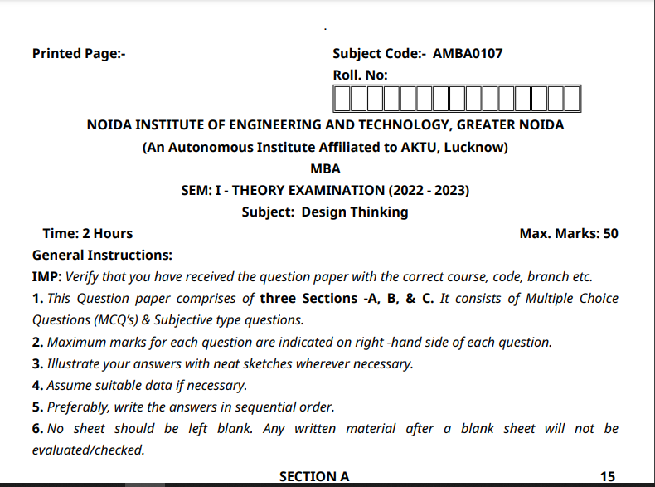
Old Question Papers

Slide 93
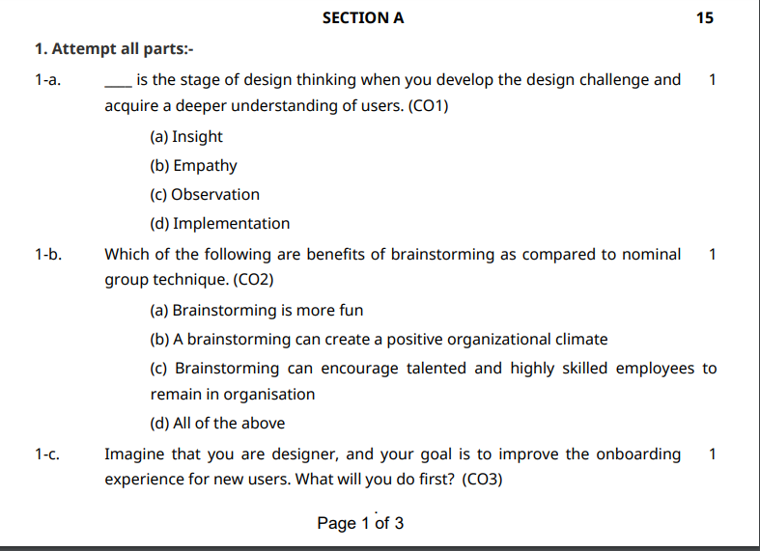
Old Question Papers

Slide 94
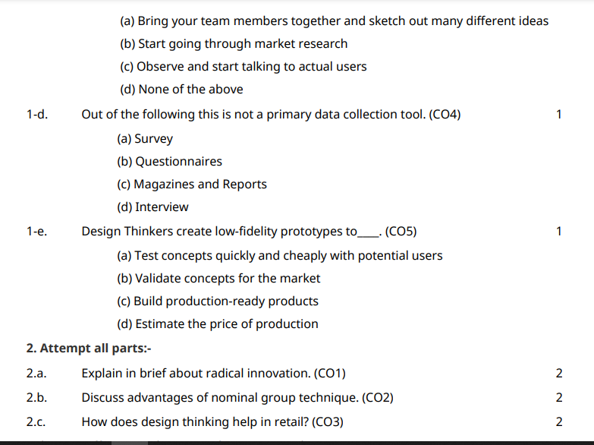
Old Question Papers

Slide 95
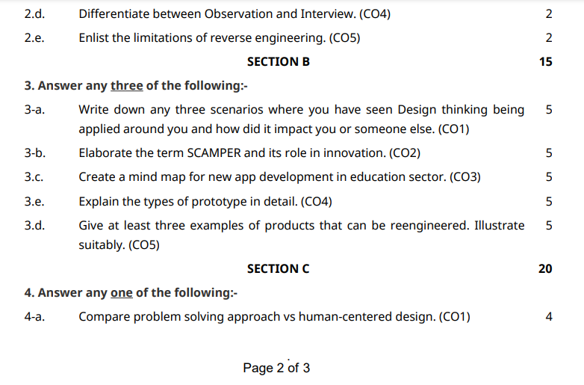
Old Question Papers

Slide 96
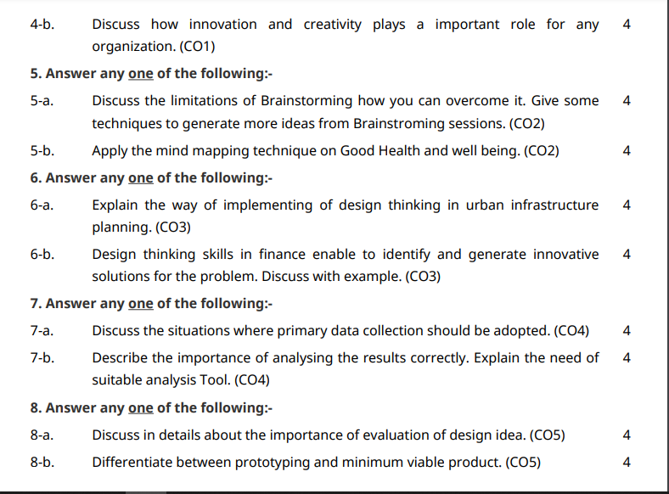
Old Question Papers

Slide 97
Expected Questions for University Exam
Differentiate between null and alternative hypothesis.
Explain the significance of Storytelling Works in Design thinking.
What do you understand by Taguchi method?
What are observation and shadowing method in design thinking?
Describe different types of random sampling methods.
Differentiate between alpha and beta testing methods.
What is the significance of Guerrilla Interviews in usability testing?
What are validation workshop?
What are different types of Software validation tools?
What are hypothesis testing methods?

Slide 98
Summary
The major topics covered are Storytelling, Mapping Personas with Storytelling, Testing design, usability and hypothesis with users, Observation and shadowing methods, user feedback, software validation tools, alpha beta testing, defect classification and random sampling etc which are important elements of design thinking. These topics are integral part of empathy which is central to design thinking. These topics have been taught to students using various case studies and activities which will help them apply these learning in future projects that they undertake. Design thinking finds its applications in business, education sector, healthcare and many more.

Slide 99
References
Thank You

